Slide 1
Product Marketer AI Assistant Automating Engaging Product Descriptions & Social Media Hashtags Project By: Lakku Sathyajith Reddy

Slide 2
Product Marketer AI Assistant
Title: Subtitle: Automating Engaging Product Descriptions & Social Media Hashtags
Problem Statement: E-commerce businesses face the challenge of consistently generating high-quality, unique, and SEO-friendly content (descriptions/hashtags) for vast product catalogs.
Why it Matters (Key Points):
Time & Cost: Manual creation is slow and expensive.
Inconsistency: Hard to maintain brand voice/SEO across thousands of products.
Market Speed: Slow content delays product launches.
Visibility: Generic content lowers conversion and search visibility.

Slide 3
Who is This For? Understanding the User & Their Pain
Target Users:
Product Marketers: Conveying product value.
E-commerce Content Teams: High-volume copy creation.
Small Business Owners: Managing all online content.
Social Media Managers: Needing relevant hshtags fast.
Frequency & Impact:
Daily/Weekly Need: Constant requirement for new/updated product content.
Scaling Issue: The problem grows exponentially with catalog size.
Creative Drain: Repetitive writing is inefficient and uninspiring.

Slide 4
Solution Overview
Solution Overview: An intelligent, Streamlit-based web application using the Groq LLM to rapidly
generate high-quality product descriptions and tailored social media hashtags.
How It Solves the Problem (Key Benefits):
Instant Content: Seconds, not hours.
Consistency & Quality: Adheres to brand tone.
SEO & Social Media Ready: Optimized output.
Resource Optimization: Frees up marketers for strategy.
Key Features:Customizable tone (incl. Funny/Humor) and length.
Generates 2 distinct descriptions + hashtags.
"Regenerate" and "Download" functionality.

Slide 5
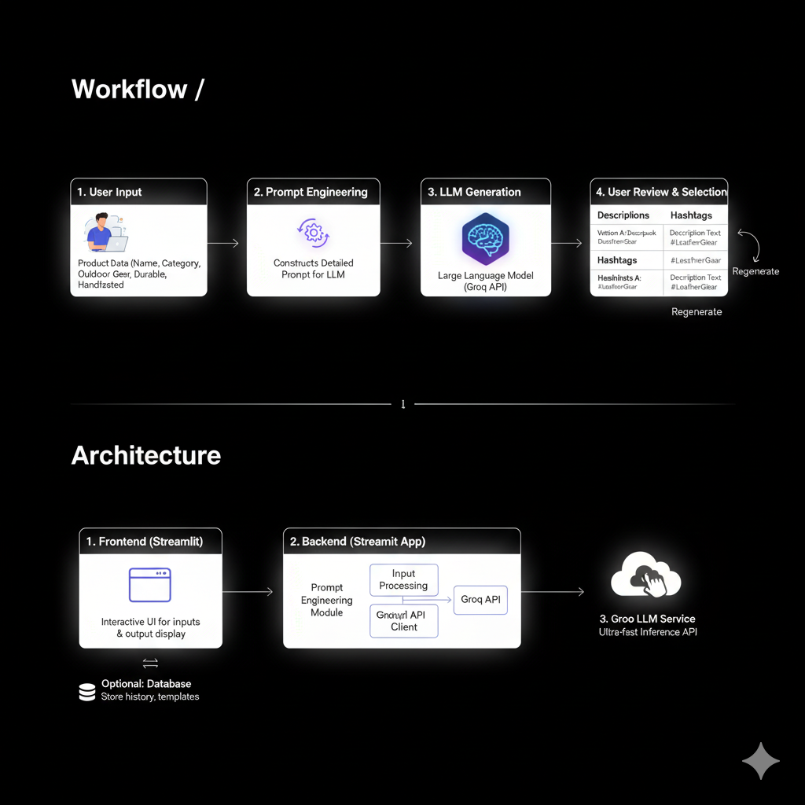
Architecture & Workflow Details
Frontend: Streamlit for the interactive web interface.
Backend: Streamlit Application managing input and securely calling the Groq API Client.
Prompt Engineering: Dynamically builds optimized prompts based on user selections.
LLM Service: Groq API ($\text{llama3-8b-8192}$ suggested) for high-speed inference.
Key Architectural Advantage: Groq ensures minimal latency, making the generation process
instant and suitable for high-volume marketing needs.
Security Note: API keys managed securely via Streamlit secrets ($\text{.env}$ or deployment secrets).

Slide 6
Impact, Prototype & Future
Expected Impact (Quantifiable Wins):
Time Savings: reduction in content generation time.
Cost Reduction: Lower reliance on external copywriting.
Faster Market Entry: Quicker product launch cycles.
Enhanced ROI: Better content drives higher conversions.
Prototype / Demo Links:
Project Done By: Lakku Sathyajith Reddy
Live App: https://aprorduct-description.streamlit.app/
GitHub Repository: https://github.com/SathyaLakku/product_marketer_ai/
Future Enhancements:
Image-to-Description via computer vision.
Multilingual generation support.
Direct integration with E-commerce platforms (Shopify, WooCommerce).

Slide 7
Thank you
Lakku Sathyajith Reddy
8088445596
lakkusathyajithreddy@gmail.com

